Slide 1

Portuguese Bank Marketing Campaign Analysis
Prepared & Presented by:
Team Alpha
Hassan Gulrez

Slide 2

Agenda
Problem Statement and Business Objective
Data Features Understanding
Exploratory Data Analysis
Feature Engineering, Outlier detection and operation
Model Selection and Metrics
Summary and Conclusion
Recommendations

Slide 3

Problem Statement and Goal
The Portuguese bank wants to sell its term deposits to new and existing clients. Its running a campaign throughout the year to variety of people coming from different financial backgrounds, educational levels, job titles etc. The bank has accumulated the user data on which campaign was run and is now looking at the dataset to figure out the likelihood of a customer getting subscribed to a term deposit and how campaign has worked so far in terms of
Total number of successful subscription
Marketing expense
High productivity
Time efficiency
ROI

Slide 4
Business Objective
Business Objectives include the following
Determine what are the important factors that contribute to the success of the marketing campaign.
Deep dive in the dataset and take out additional features to find how they impact the term deposit subscription
Build a model to predict the outcome of future campaigns.
Identify target customers who are most likely to subscribe to a term deposit.

Slide 5
Dataset Features Understanding
Client Demographics
Age (numerical)
Job (categorical)
Economic Information
Consumer price index (numerical)
Marketing Information
Communication method (categorical)
Pdays: days passed when client contacted from last campaign (numerical)
Marital status (categorical)
Educational
(categorical)
Default (categorical)
Consumer confidence index (numerical)
Euribor 3month rate (numerical)
Num of employed (numerical)
Poutcome (categorical)
Campaign: contact perform during campaign (numerical)
Contact Month (categorical)
Contact day of week (categorical)
Call Duration (numerical)
Housing(categorical)
Loan (categorical)
Previous: number of contacts made before this campaign (numerical)
Emp variation rate (numerical)
The data set can be classified into 3 different categories.
Bank Marketing source data can be accessed on: https://archive.ics.uci.edu/ml/datasets/bank+marketing

Slide 6
Data Science Approach
1. Exploratory Data Analysis
3. Hot Encoding and Binning
6. Modelling
4. Checking missing values and Outliers operation
5. Correlation and Feature Importance
2. Feature Engineering

Slide 7
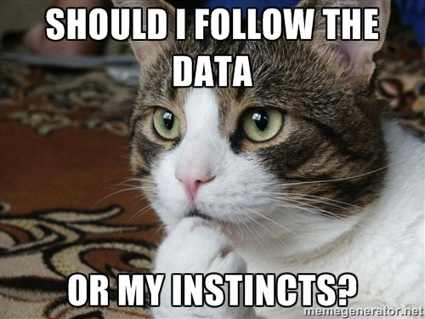
EDA- Exploratory Data Analysis

Slide 8
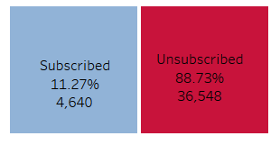
Term Deposit Subscription Statistics Number of Observations: 41,188 instances collected

Slide 9
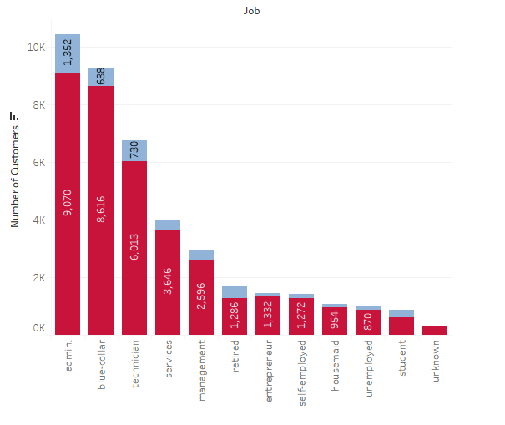
Job vs Term Deposit Subscription
What occupation should we target more?
Analysis - Admin and Blue Collar Individuals are more likely to sign up for the Term deposits as compare to other occupations

Slide 10
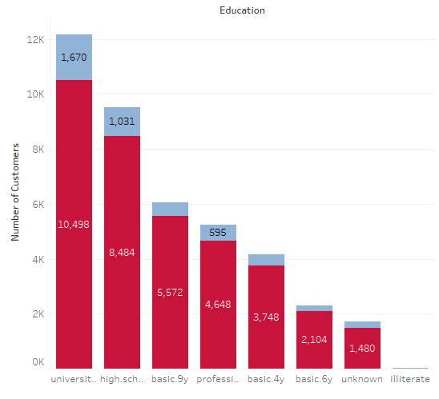
Education Vs Term Deposit Subscription
What educational level should we target more?
Analysis – University Degree holders are more likely to sign up for the Term deposits as compare to other occupations. Around 36% of the total that signed up held university degrees. More likely, they have more awareness and know the benefit.

Slide 11
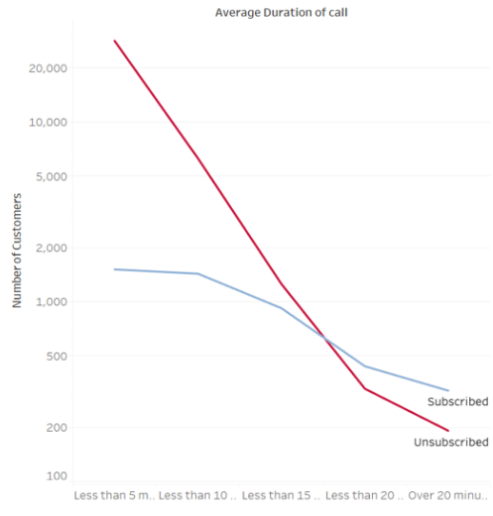
Duration Vs Term Deposit Subscription
Does call duration has any significance?
Analysis – Longer call duration plays an important role in term deposit subscription.
Focus more on getting clients to talk for longer duration.

Slide 12
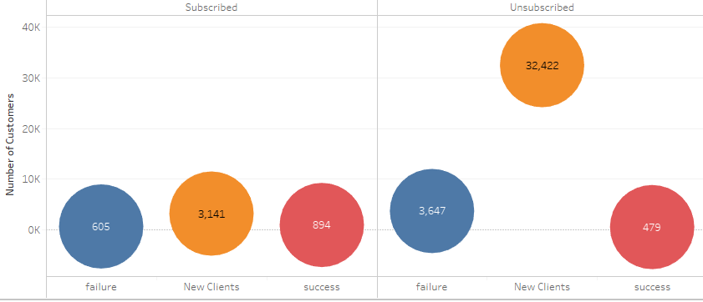
Changes from Previous Campaign to New Campaign
Did the customer changed their decision related to term deposit.
- 605 customers who did not subscribe in the last campaign did subscribe this time but 3647 clients still did not subscribe.
- 894 customers who did subscribe in the last campaign also subscribed this time but 479 clients who were successful last time did not sign up.

Slide 13
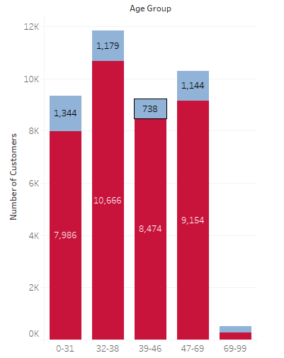
Age Group vs Term Deposit Subscription
Does age play a role in term deposit subscription?
-Most clients are aged less than 38 should be targeted to get higher numbers of subscription. However, ages from 39-69 also showed interest.
-Less focus on age greater than 69 as it is our outlier

Slide 14
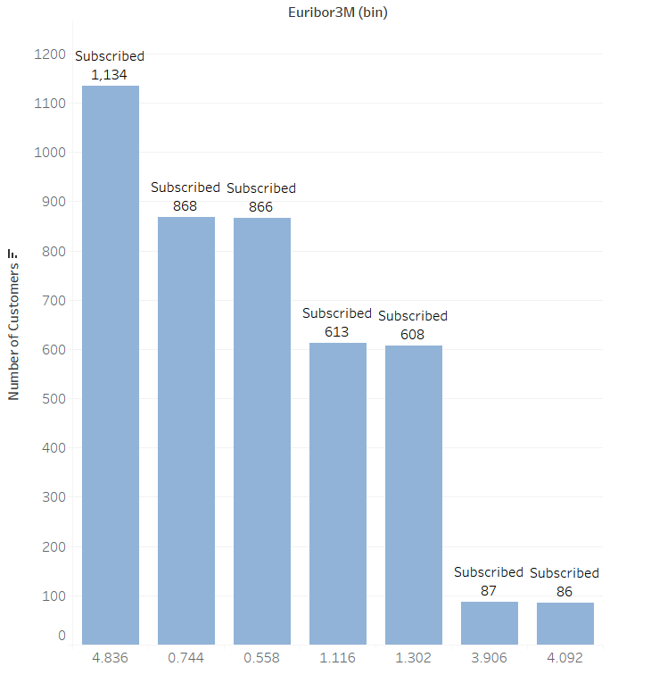
Euribor3m vs Success
Does Higher Euribor changes the decision ?
- No, Euribor alone does not seem to be making a difference.

Slide 15
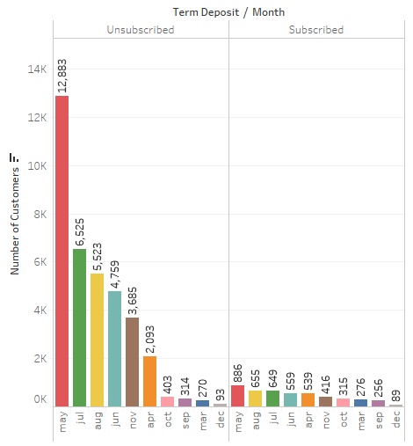
Month vs Outcome
What months are more productive?
-May, June, July and Augusts are the most revenue generating months. Approx. 60% people signed up during these months.

Slide 16
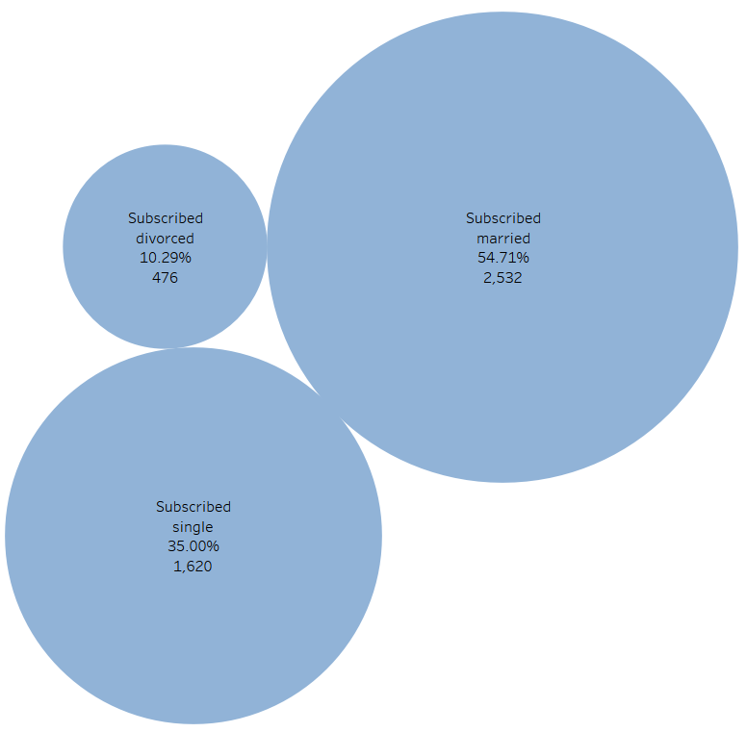
Marital vs Outcome
What Marital Status are more inclined towards term deposits?
- Almost 55% who signed up for term deposit are Married.

Slide 17
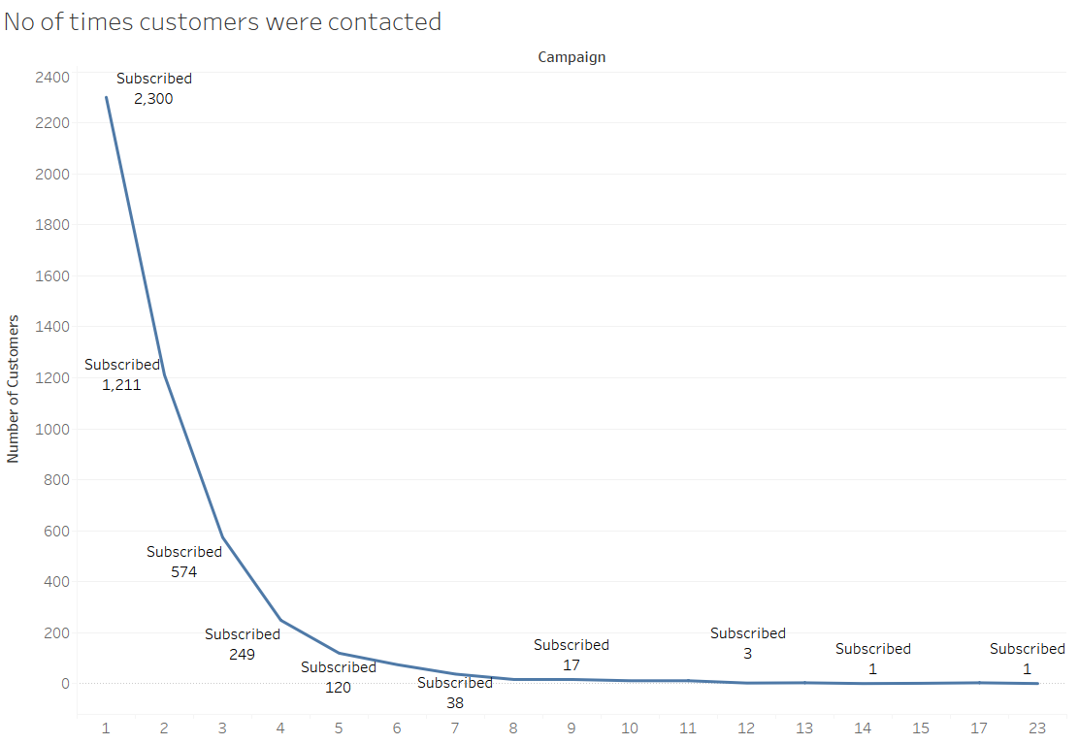
Number of times contacted for the campaign
How many times should we approach the clients for a deposit?
- If the client is not convinced till the 12 time than customer should be dropped from the marketing list.

Slide 18
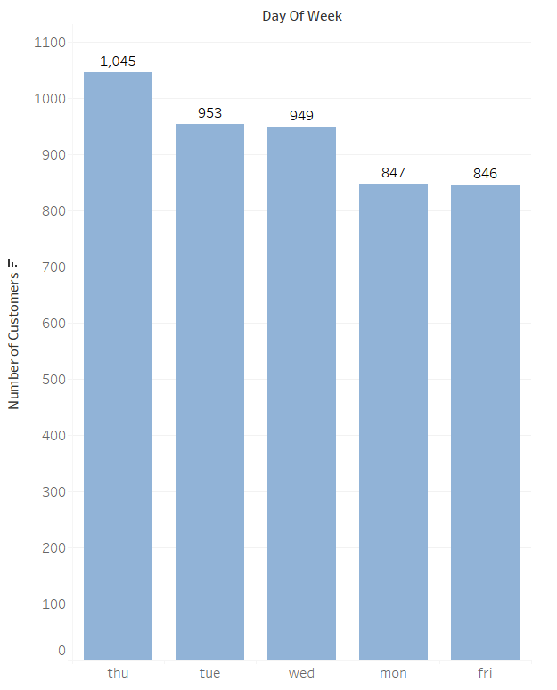
Days of the week
What day should we do the campaign?
Thursday is the best day for carrying out term deposit campaign.

Slide 19
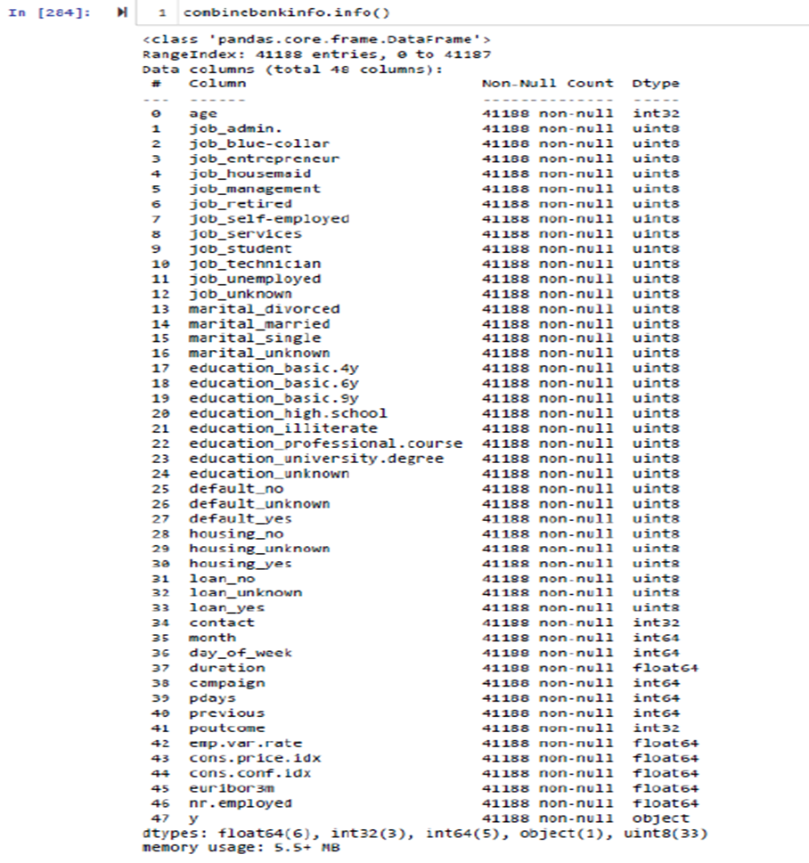

Feature Engineering
After one hot encoding, binning and data cleaning we did feature Engineering and produced 47 features. Previously there were 21 features.

Slide 20
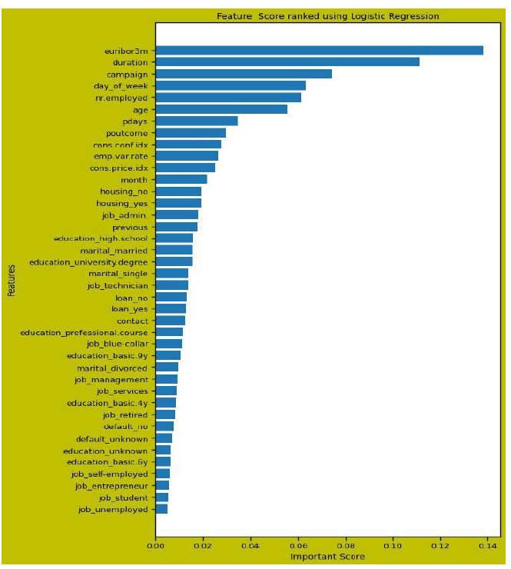
Feature Importance
Logistic Regression technique is used to plot top Features:
Euribor3m
Duration
Campaign
Days of the week

Slide 21
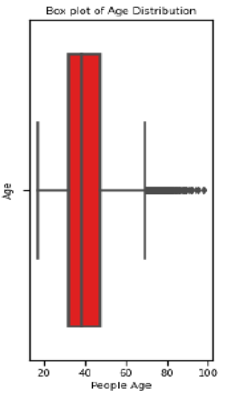
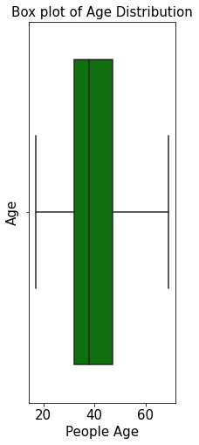
Data Preparation – Dealing with AGE Outliers.
- No Null values in age were found
- Any age below 9.5 and above 69.5 was considered an outlier
- Outliers were substituted with the mean overall Age

Slide 22
Random Forest Classification
 | 0 | 1
0 | 10491 | 449
1 | 874 | 570
Training Score: 96.3%
Precision = .95
Recall = .93
F1 Score = .96
Accuracy = 89%

Slide 23
Logistic Regression
 | 0 | 1
0 | 10794 | 146
1 | 1017 | 400
Training Score: 90.4%
Precision = .96
Recall = .91
F1 Score = .95
Accuracy = 90.6%

Slide 24
Linear SVC
 | 0 | 1
0 | 10870 | 70
1 | 1155 | 262
Training Score: 90.0%
Precision = .98
Recall = .90
F1 Score = .95
Accuracy = 90%

Slide 25
Decision Tree
 | 0 | 1
0 | 10367 | 573
1 | 892 | 525
Training Score: 96.3%
Precision = .95
Recall = .92
F1 Score = .96
Accuracy = 88%

Slide 26
Model Comparison
 | Training Score
Random Forest | 96.3%
Decision Tree | 96.3%
Logistic Regression | 90.45%
Support Vector Machines | 90.0%

Slide 27
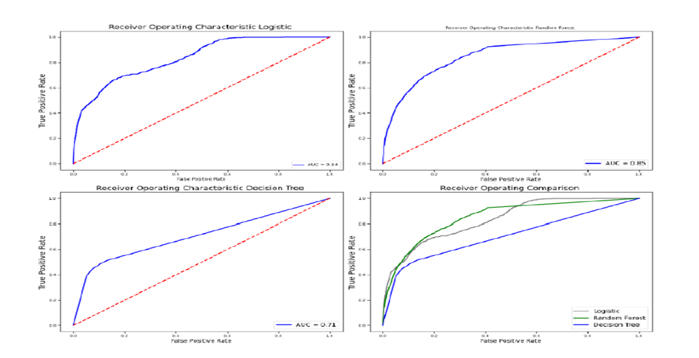
Best Fit Model Selection based on ROC-AUC Curve

Slide 28
Summary
Many features have planned a role in term deposit subscription.
Although Euribor3m should influence the customers to purchase term deposit but the data shows Euribor3m does not excite the customers.
In order to make the campaign more successful we should add more features in the data sets like competitors rate offerings, economic condition(recession , boom).
After plotting the ROC and AUC Curve, we could conclude that Random Forest is the best model among all three models which we have chosen due to maximum area under the curve.

Slide 29

Recommendations
We highly recommend that bank should talk to the customers for longer time in order to clarify customers queries and so to get a term deposit subscription
When Euribor3m is high bank should put more efforts as customers will earn higher returns and will be highly motivated to sign up for a term deposit.
Keep on updating the model

Slide 30

For question / concern or need further clarification, kindly contact anyone from team. Hassan Gulrez: gulrezh@sheridan.desire2learn.com Muhammad Samad Hassan: hassan29@sheridan.desire2learn.com Pratik Parikh : pariprat@sheridan.desire2learn.com Muhammad Nadeem : nadeem2@sheridan.desire2learn.com
Thank you!

